Slide 1
COVID 19 mortality risk analysis
File created on: 9/6/2021 6:53:36 PM

Slide 2

What are the risk factors of dying from infections related to
severe acute respiratory syndrome of coronavirus 2 (SARS-CoV-2),
COVID-19?
Is it race/ethnicity?
Geographic location?
Could it be a combination of factors?
Notes:
Study Purpose
Is to rank the risk of dying from COVID from CDC mortality data by geographic location and age and race/hispanic ethnicity
We know that certain age groups are disproportionately affected by COVID-19 having greater risk of dying.
However, it is not clear if belonging to a certain ethnic or racial group is associated with the increased risk.
Mortality gradients between different states and geographic locations are also not well elucidated.

Slide 3
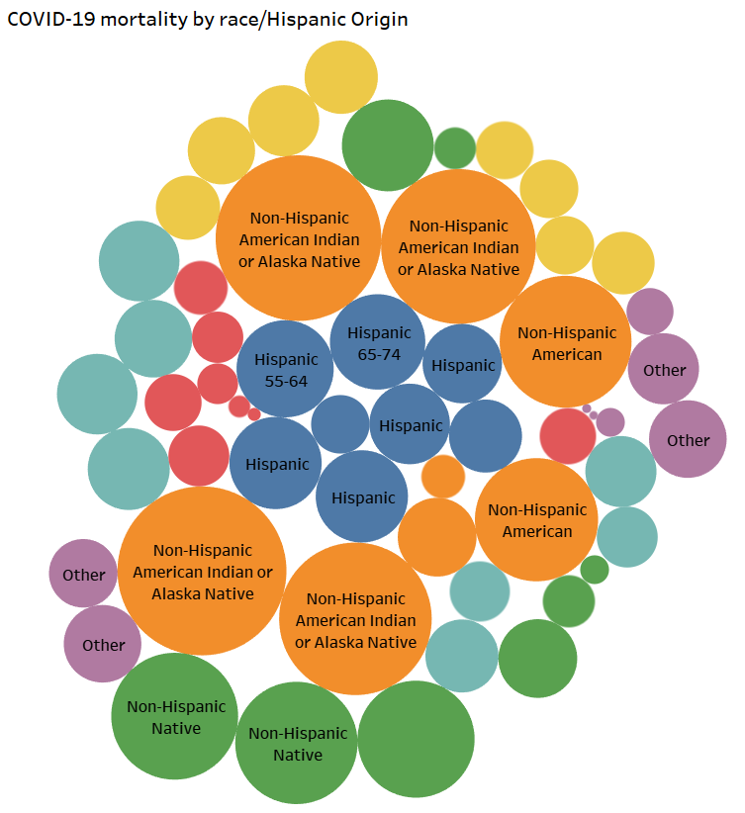
To Rank the Risk Causes using
CDC COVID-19 Cases and Deaths by State Data
Data Source:
https://data.cdc.gov/NCHS/Distribution-of-COVID-19-Deaths-and-Populations-by/jwta-jxbg/data

Slide 4
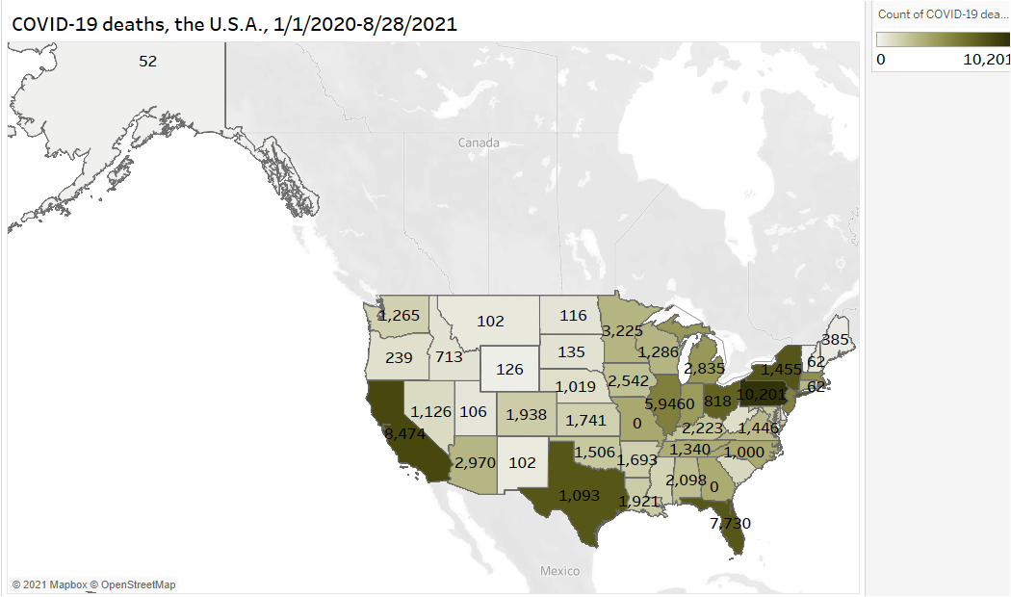
CDC COVID-19 Cases and Deaths by State

Slide 5
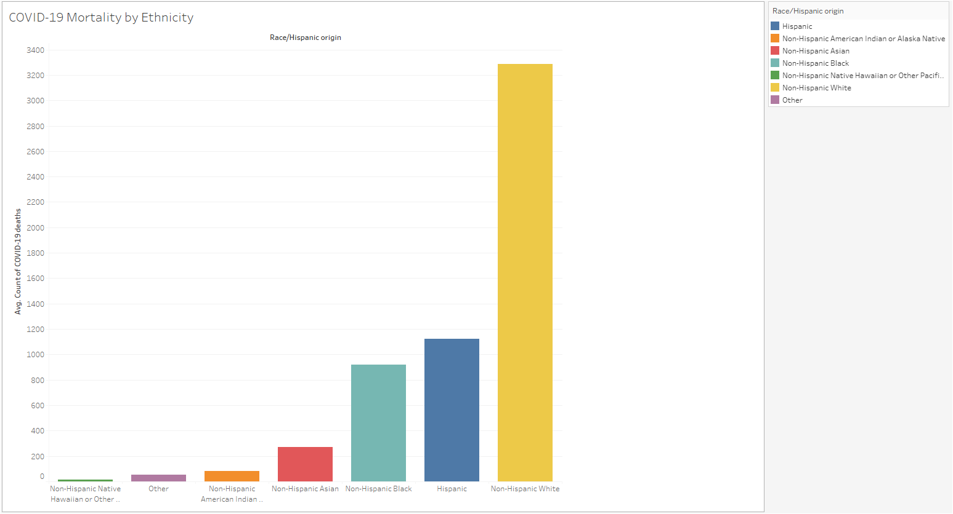
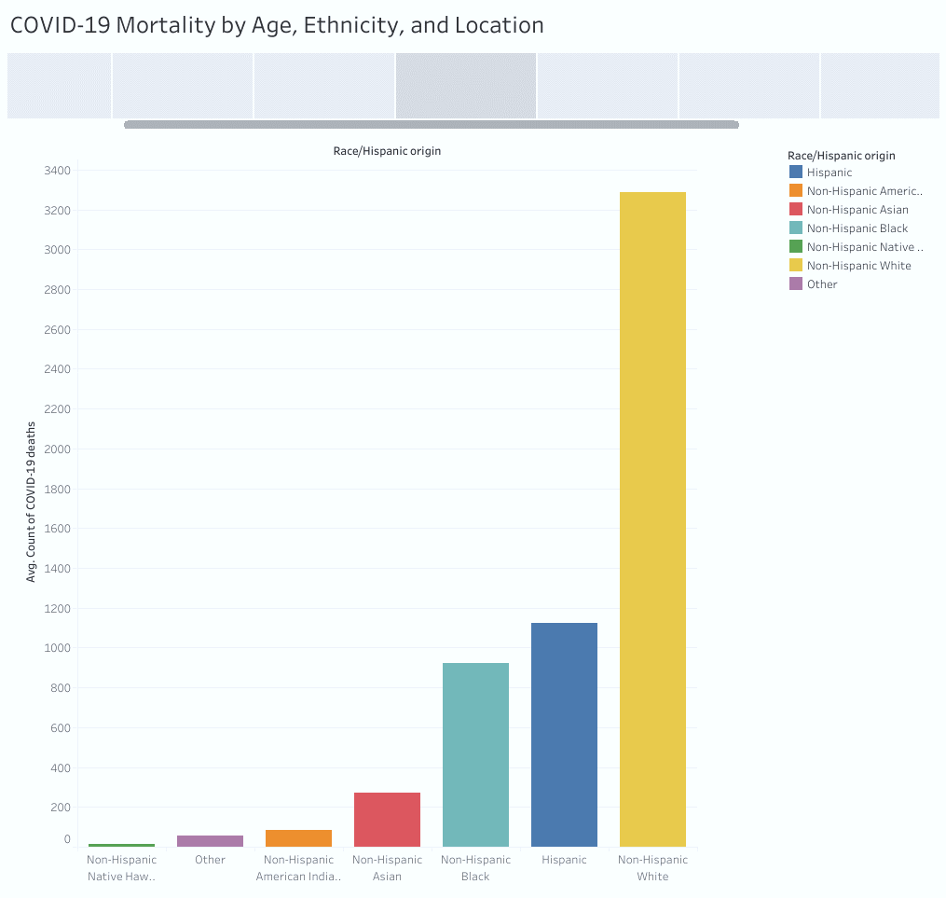
Unadjusted COVID-19 Mortality Risk
by Race/Hispanic origin
Notes:
COVID-19 mortality rate unadjusted to the proportion of population seems to be the highest among white non-Hispanic White population.

Slide 6
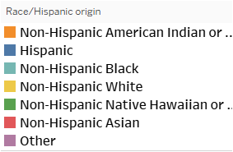
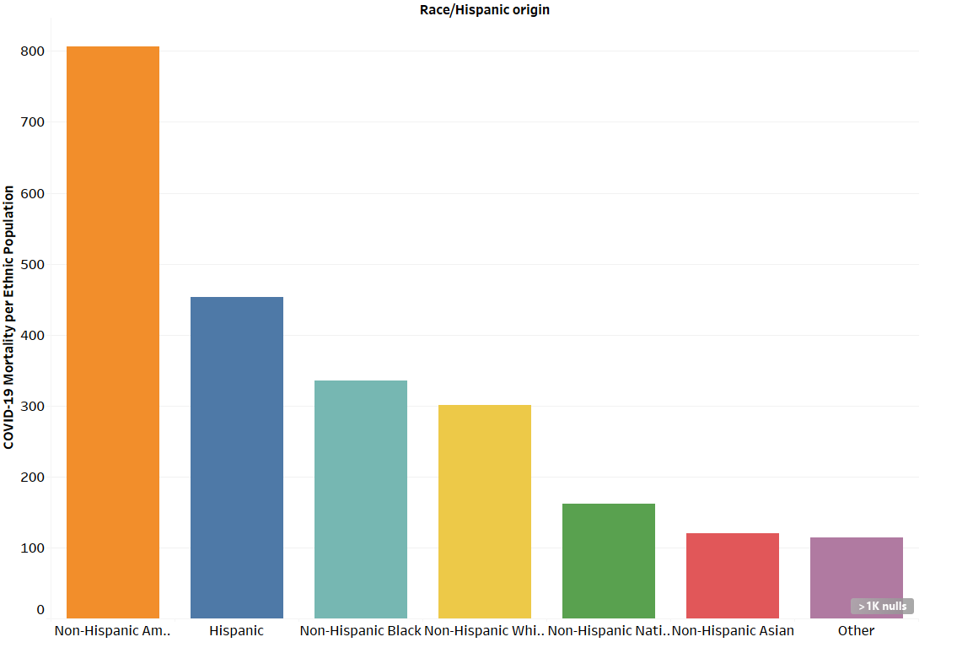
Adjusted COVID –19 Mortality Risk
by Race/Hispanic origin
Notes:
Mortality rate adjusted for population density is the highest among American Indians and Alaskan Natives.
Non-Hispanic Black population has the second highest rate, although the difference may be not significant when compared to that among Hispanic and White.
Mortality rates among Hispanic and White do not seem to be significantly different.
The rate is the lowest in Asian population.

Slide 7
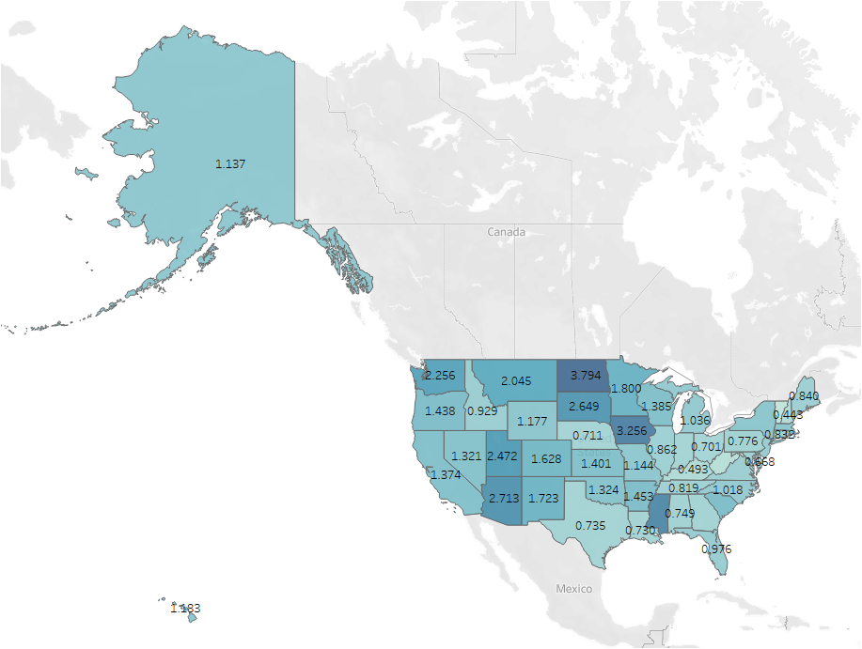

COVID –19 Adjusted Mortality
North Dakota, Iowa, Mississippi, Arizona, and Utah
Notes:
With rate adjusted per population density, the states with the highest mortality rate are North Dakota, Iowa, Mississippi, Arizona, and Utah.
Limitation: there could be significant differences in State reporting requirements.
"The weighted population distributions were calculated as follows. County-level population counts by race and Hispanic origin were multiplied by the corresponding total count of COVID-19 deaths by county (of residence). These weighted counts were then summed to the state (or national) level. The percentage of the population within each race and Hispanic origin group by state (or for the US) was then estimated using these weighted counts. Counties with no COVID-19 deaths received a weight of zero, and thus do not contribute to the weighted population totals. Population counts for counties with large numbers of COVID-19 deaths are upweighted proportional to their numbers of COVID-19 deaths. These weighted population distributions ensure that the population estimates and percentages of COVID-19 deaths represent comparable geographic areas, in order to provide information about whether certain racial and ethnic subgroups are experiencing a disproportionate burden of COVID-19 mortality. For example, assume that 75% of the total number of COVID-19 deaths occurred in a single county, County X, while the other 25% of COVID-19 deaths occurred in County Y, and all other counties reported zero deaths. The weighted population counts for County X would contribute 75% of the total population counts, while the population counts for County Y would contribute 25% of the total, while all other counties with zero COVID-19 deaths would not count toward the total population counts. In other words, County X population counts would be weighted by 0.75, County Y population counts would be weighted by 0.25, and all other county population counts would be weighted by 0. These weighted counts are then summed to a total (either state or US), and then the percent of the population in each race and Hispanic origin group is computed. These weighted distributions ensure that the population distributions are as closely matched to the geographic areas where COVID-19 deaths are occurring, to the extent possible." (https://www.cdc.gov/nchs/nvss/vsrr/covid19/tech_notes.htm)

Slide 8
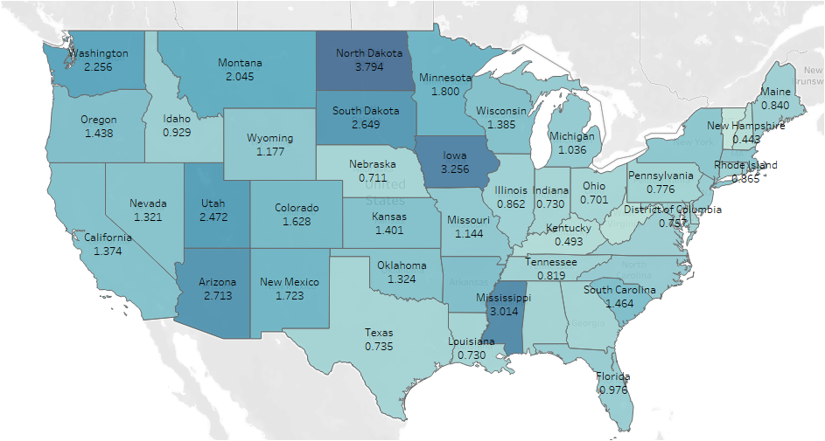
North Dakota
Iowa Mississippi Arizona, Utah
COVID –19 Adjusted Mortality
Notes:
With rate adjusted per population density, the states with the highest mortality rate are North Dakota, Iowa, Mississippi, Arizona, and Utah.
Limitation: there could be significant differences in State reporting requirements.
"The weighted population distributions were calculated as follows. County-level population counts by race and Hispanic origin were multiplied by the corresponding total count of COVID-19 deaths by county (of residence). These weighted counts were then summed to the state (or national) level. The percentage of the population within each race and Hispanic origin group by state (or for the US) was then estimated using these weighted counts. Counties with no COVID-19 deaths received a weight of zero, and thus do not contribute to the weighted population totals. Population counts for counties with large numbers of COVID-19 deaths are upweighted proportional to their numbers of COVID-19 deaths. These weighted population distributions ensure that the population estimates and percentages of COVID-19 deaths represent comparable geographic areas, in order to provide information about whether certain racial and ethnic subgroups are experiencing a disproportionate burden of COVID-19 mortality. For example, assume that 75% of the total number of COVID-19 deaths occurred in a single county, County X, while the other 25% of COVID-19 deaths occurred in County Y, and all other counties reported zero deaths. The weighted population counts for County X would contribute 75% of the total population counts, while the population counts for County Y would contribute 25% of the total, while all other counties with zero COVID-19 deaths would not count toward the total population counts. In other words, County X population counts would be weighted by 0.75, County Y population counts would be weighted by 0.25, and all other county population counts would be weighted by 0. These weighted counts are then summed to a total (either state or US), and then the percent of the population in each race and Hispanic origin group is computed. These weighted distributions ensure that the population distributions are as closely matched to the geographic areas where COVID-19 deaths are occurring, to the extent possible." (https://www.cdc.gov/nchs/nvss/vsrr/covid19/tech_notes.htm)

Slide 9
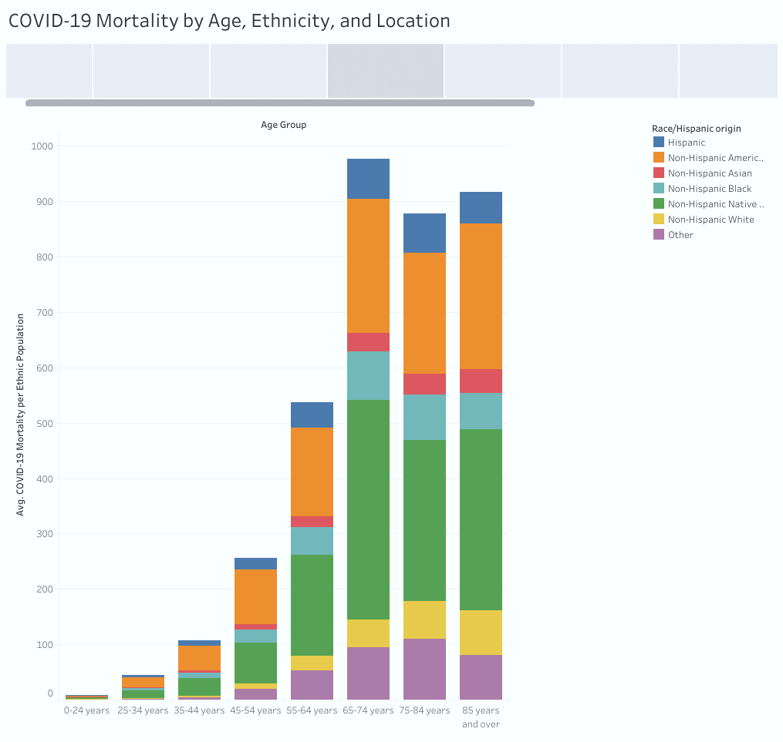
COVID –19 Mortality by Age, Race/Hispanic origin
Notes:
The risk for every ethnic group nearly doubles with every 10 years of age until the age 65 y.o.
The risk of dying from COVID-19 is the highest among 65-74 y.o., particularly for Native Hawaiian and American Indians.
This risk is also high for 85 y.o. and older and 75-84 y.o., again particularly among Native Hawaiian and American Indians.

Slide 10
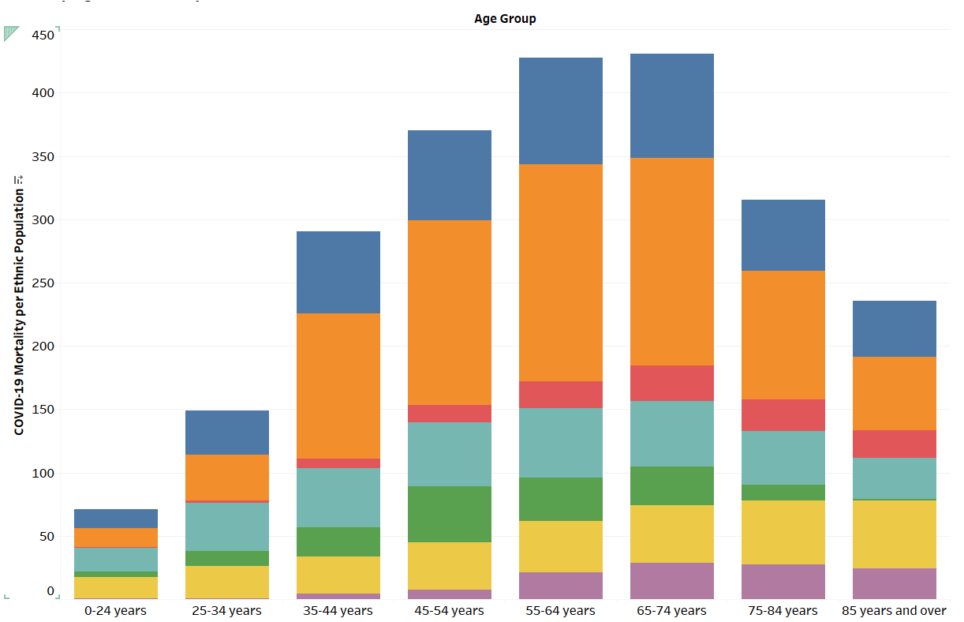
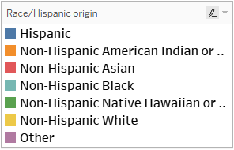
COVID –19 Adjusted Mortality by Age and Race/Hispanic origin
Notes:
The risk for every ethnic group nearly doubles with every 10 years of age until the age 65 y.o.
The risk of dying from COVID-19 is the highest among 65-74 y.o., particularly for Native Hawaiian and American Indians.
This risk is also high for 85 y.o. and older and 75-84 y.o., again particularly among Native Hawaiian and American Indians.

Slide 11
Assumption
Previous incidence reflects future risk
COVID-19 strain is not a significant distribution factor
Notes:
Limitation: this dataset does not consider sex/gender, other demographic and socio-economic factors
Data are impacted by later incomplete records of the later 4-6 weeks.
Reporting variations exit. Medical/osteopathic diagnostic variations could not be excluded.
Place of death could be different from place of residence or the place of infection origin

Slide 12
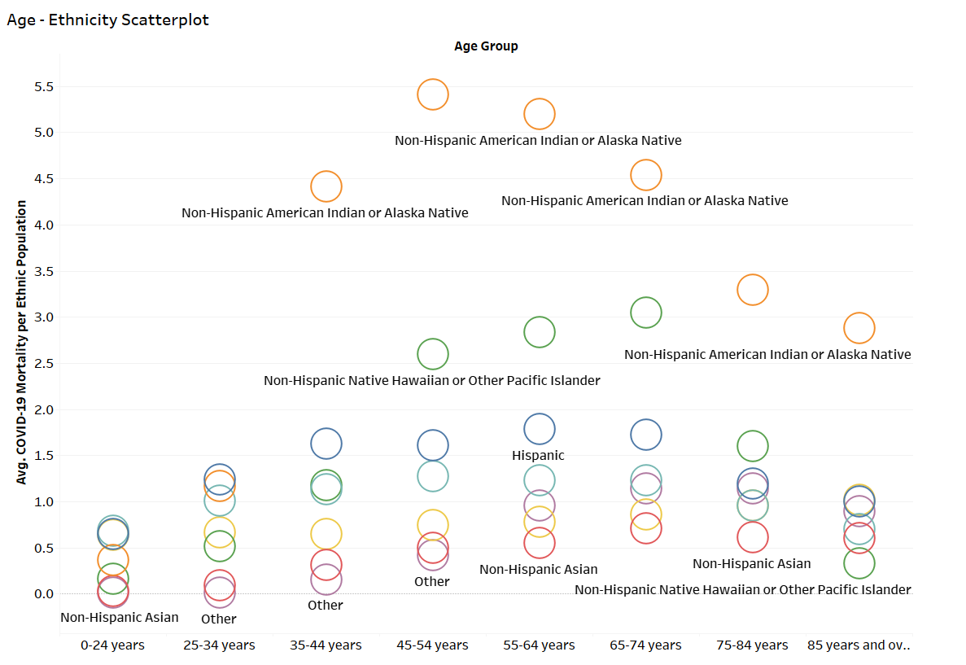
Mortality Risk
Notes:
American Indians and Alaskan Natives have significantly greater risk of mortality
American Indians and Native Hawaiians of 65y.o. - 74y.o. have the highest risk

Slide 13
CONCLUSION
The risk is the highest among the non-Hispanic American Indian and Alaska Native (AIAN) population
By age, the risk increases every 10 years of age
until the age of 74 y.o.
The risk is the highest among 45-74 y.o.
AIAN
Hispanic
Notes:
States with higher mortality rates seem to be more Northern and rural with greater distances to tertiary medical centers (access to care).
Better tracking of the cause of death?

Slide 14
Race/Hispanic Origin and Age and the risk of dying from COVID –19 associated infection
Notes:
The risk of dying from COVID – 19 infections increases every 10 years of age until the age 74 y.o.
The risk of dying from COVID-19 is the highest among 65-74 y.o., particularly for American Indians.
This risk is also high for 55-64 y.o. and 45-54 y.o. particularly among American Indians

Slide 15
Questions for future research
Rural areas?
Reduced access to medical centers?
A combination of factors?
Notes:
States with higher mortality rates seem to be more Northern and rural with greater distances to tertiary medical centers (access to care).
Better tracking of the cause of death?

Slide 16
Data Source:
CDC. Distribution of COVID-19 Deaths and Populations, by Jurisdiction, Age, and Race and Hispanic Origin. Retrieved 9/1/2021
https://data.cdc.gov/NCHS/Distribution-of-COVID-19-Deaths-and-Populations-by/jwta-jxbg
https://data.cdc.gov/NCHS/Provisional-COVID-19-Deaths-Distribution-of-Deaths/pj7m-y5uh
Notes:
Limitation: there could be differences in State reporting requirements.

